Slide 1
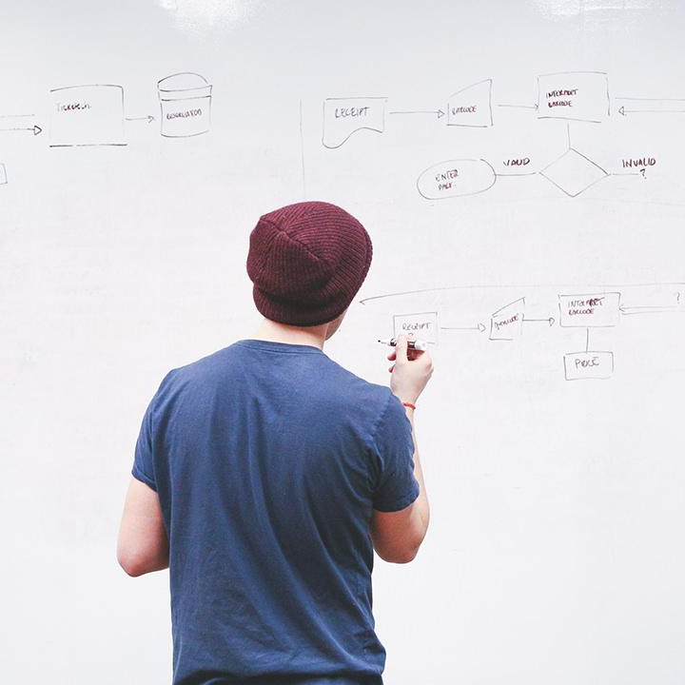
HELLO!
Here 1Crore Projects
I am here because I love to give presentations.
You can find me at @1CROREPROJECTS

Slide 2
Blockchain-based Decentralized Authentication Modeling Scheme in Edge and IoT Environment

Slide 3

AIM OF PROJECT
The main aim of the project to identify a block chain by a different block for the data and maintain safe mood when attackers are attack the particular block and the Blockchain-based Decentralized Authentication Modeling Scheme in Edge and IoT Environment

Slide 4
ABSTRACT
Authentication is the first entrance to kinds of information systems; however, traditional centered single-side authentication is weak and fragile, which has security risk of single-side failure or breakdown caused by outside attacks or internal cheating. In the edge and IoT environment. Blockchain can apply edge devices to better serve the Internet of Things and provide decentralized high security service solutions.

Slide 5
INTRODUCTION
The most important entrances to kinds of information systems, authentication plays a prominent role in information system protection, which ensures the right user have access to the right system with the right identity. Currently, the identity authentication technologies are consist of
1)Password-based authentication.
2) Certificate-based authentication.
3) Biotechnology-based authentication, for instance, face, fingerprint or sound recognition.

Slide 6
EXISTING SYSTEM
The problems existing in the current identity authentication protocol, a BlockAuth Scheme is proposed.
The registration protocol, consensus mechanism of security enhancement and the authentication protocol are studied in detail.

Slide 7
DISADVANTAGES
Lows of security
The user without login, Encrypted data cannot store in block chain

Slide 8
PROPOSED SYSTEM
The proposed Block Auth scheme has following advantages: collaborative authentication, strong fault tolerance, decentralization, stability and high-level security.
In addition, this scheme can meet the authentication requirements of multiple scenarios and development demand of the international standard authentication scheme.

Slide 9
ADVANTAGES
Data was secure
By the different fields create a unique block is used to search a user need.

Slide 10
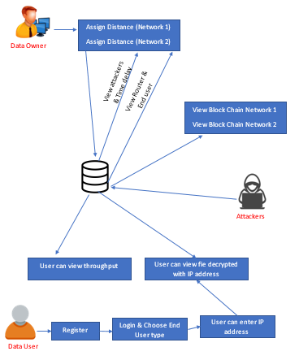
SYSTEM ARCHITECTURE

Slide 11
MODULES
In this project we have five modules
1. Data Owner
2. Data User
3.Cloud Server
4.Network 1
5.Network 2

Slide 12
Data Owner
Register the account with the basic information
After authorized by cloud owner can login the account
Make a request for key
View key and upload the file with the encrypted format, If we need to select the network and node for file uploaded.
View files
Logout

Slide 13
Data User
Register the account with the basic information
After authorized by cloud user can login the account
View uploaded files with encrypted format
Make a request for particular file
If we enter the key correctly means, the file should be downloaded.
After downloaded it should be decrypted format.
Logout

Slide 14
Cloud Server
Login the account with the correct credentials
View owner and authorize them.
View user and authorize them.
View owner request and Send key for File upload
Send Decryption Key
View all uploaded files
Graph
Logout

Slide 15
Network 1
Login the account with correct credentials
View network1 uploaded files
logout

Slide 16
Network 2
Login the account with correct credentials
View network2 uploaded files
Logout

Slide 17
HARDWARE REQUIREMENTS
System | Intel i3 and above
Hard Disk | 40GB
RAM | Minimum 4GB
Processor | 64-bit, four-core, 2.5 GHz minimum per core

Slide 18
SOFTWARE REQUIREMENTS
Front End Language | HTML, CSS, JAVA, JSP SERVELTS
Backend | My SQL
Operating System | Windows 10 or 11
IDE | JAVADEVELIPEMENKIT

Slide 19
FUTURE WORK
As a future direction, we are looking toward improving the credibility of our framework by adding incentives to encourage honest participation of the users by adding Data To Store in More Secure in Unique Block Chain.

Slide 20
CONCLUSION
This scheme proposed by us can meet the authentication requirements of multiple scenarios and development demand of the international standard authentication scheme.

Slide 21
REFERENCE
[1] Proc. Roy. Soc. A Math. Phys. Eng. Sci., vol. 426, no. 1871, pp. 233-271, 1989.
[2] M. Abadi and M. R. Tuttle, "A semantics for a logic of authentication", Proc. 10th Annu. ACM Symp. Princ. Distrib. Comput., pp. 201-216, 1991.
[3] Hung-Yu Chien. SASI: A New Ultralightweight RFID Authentication Protocol Providing Strong Authentication and Strong Integrity. IEEE Transactions on Dependable and Secure Computing, vol.4, pp.227-340, 2007.

Slide 22
THANKS!
Any questions?
You can find me at
Reach us – 1croreprojects@gmail.com
Contact / Whatsapp: 7708 150 152 / 9751 800 789 / 790 432 0834

